Slide 1
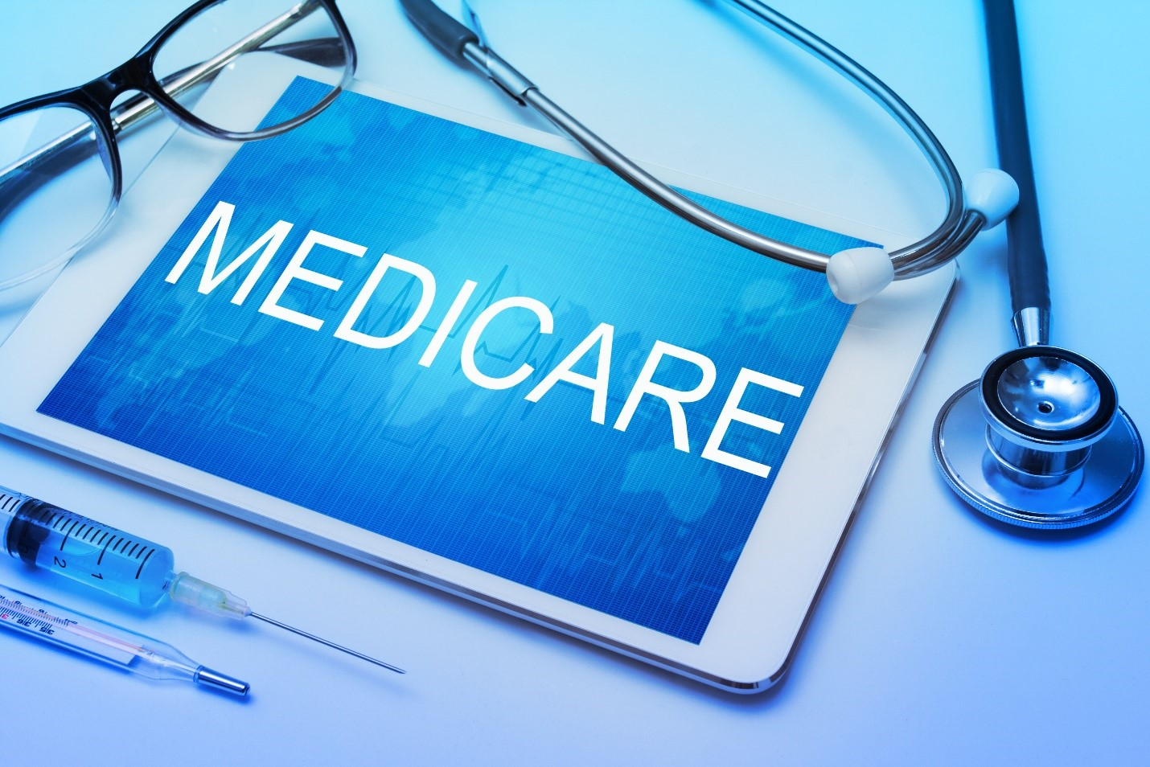
E-Medicare
RLL Project - Group 06

Slide 2
Team Members :
Github Link: https://github.com/priyankamv279/E-Medicare.git
Patnoor Noor Mohammed
Pola Lokesh
Pentakoti Naga Sravan Kumar
Pravin Shankar Kakad
Pinninti Navya
Priyanka M V
Pittala Manasa
Rakesh Subudhi

Slide 3
Abstract
The purpose of E-Medicare application is to automate the existing manual system by the help of computerized equipment's and full-fledged computer software, fulfilling their requirements, so that their valuable data can be stored for a longer period with easy accessing and manipulation of the same.
E-Medicare System, as described above, can lead to error free, secure, reliable and fast management system.
It also provides the time and effort exerted by the staff and ensures the accuracy of the patient's internal medical disbursement as well as the control of the disbursed quantities.

Slide 4
Introduction
The main aim of this project is to develop an online web portal that can handle Medicine booking. In recent times, mobile healthcare apps become more trending due to pandemic crisis. People are reluctant to leave their home in the aftermath of the coronavirus epidemic to purchase even basic commodities. Online medicine delivery apps allow for delivery at your doorstep.
In this, users can choose a medicine section of their choices and go through all the items that the system provides. Users can then select the desired drug items, add them to cart and then proceed to payment.
Our system solves the problems of going for searching medicines and saves transport cost.We are ensuring a fast delivery system which is safe and reliable. Customers can save both time and money.

Slide 5
Proposed System
The proposed medical Booking Store System will completely Revolutionize the industry.
Searching of products, order placing, billing and product stock can be maintained by a single click.
The payment of the order can also be done by credit cards

Slide 6
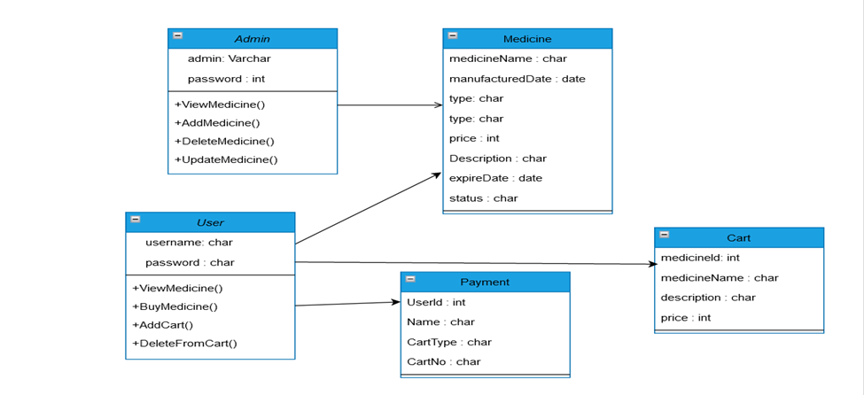
Entity Relationship Diagram
MedicineName : char
Price of product : int

Slide 7
Technology Used
HTML : Page layout has been designed in HTML.
CSS : CSS has been used for all the designing part.
Java : All the business logic has been written in Java.
Angular CLI : Command-line interface tool that we use to initialize.
MySQL : MySQL database has been used as database for the project.
Hibernate : Used for object table mapping
Spring-boot : Server side setup.
Tomcat : Server.

Slide 8
System Overview:
The “E-Medicare” should support basic functionalities for all below listed users
Login Module: Used for managing the login details.
Users Module: Used for managing the users of the system.
Admin Module: Used for managing medicine details and user information.
Medicine Module: Used for managing the Medicine details.
Contact_us: Used if customer is having complaints.
Cart Module: Used for managing the details of Cart.
Payment Module: Used for managing the details of PaymeNT. add update module…

Slide 9
Functional Flow
Admin
DES Application
HTTP /GET
HTTP Response
Database
User
GUI
Server

Slide 10
Environment
Server – Apache Tomcat 8.5
Database – MySQL
My SQL J Connector
Node Version 10
Angular CLI
JDK 1.8
Eclipse IDE or Spring Tool Suite

Slide 11
Case Diagram
Add/Delete/Update
Medicine details
View all Medicines and
Own cart Medicines
Admin
User
Purchase Medicines
View all Medicines and
Users

Slide 12
Unit Testing:
JUnit is a unit testing framework for Java programming language. It plays a crucial role test-driven development, and is a family of unit testing frameworks collectively known as xUnit.
Features of JUnit:· J
Unit is an open source framework, which is used for writing and running tests.
Provides annotations to identify test methods.
Provides assertions for testing expected results.

Slide 13
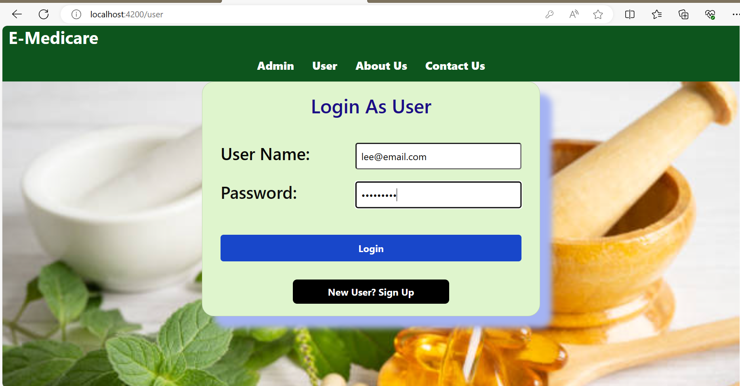
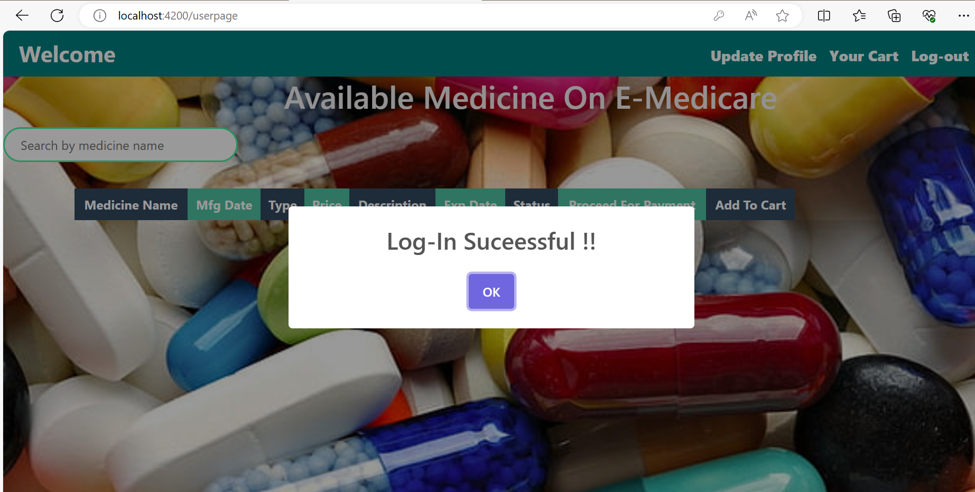
Output Screenshots
Admin Login

Slide 14
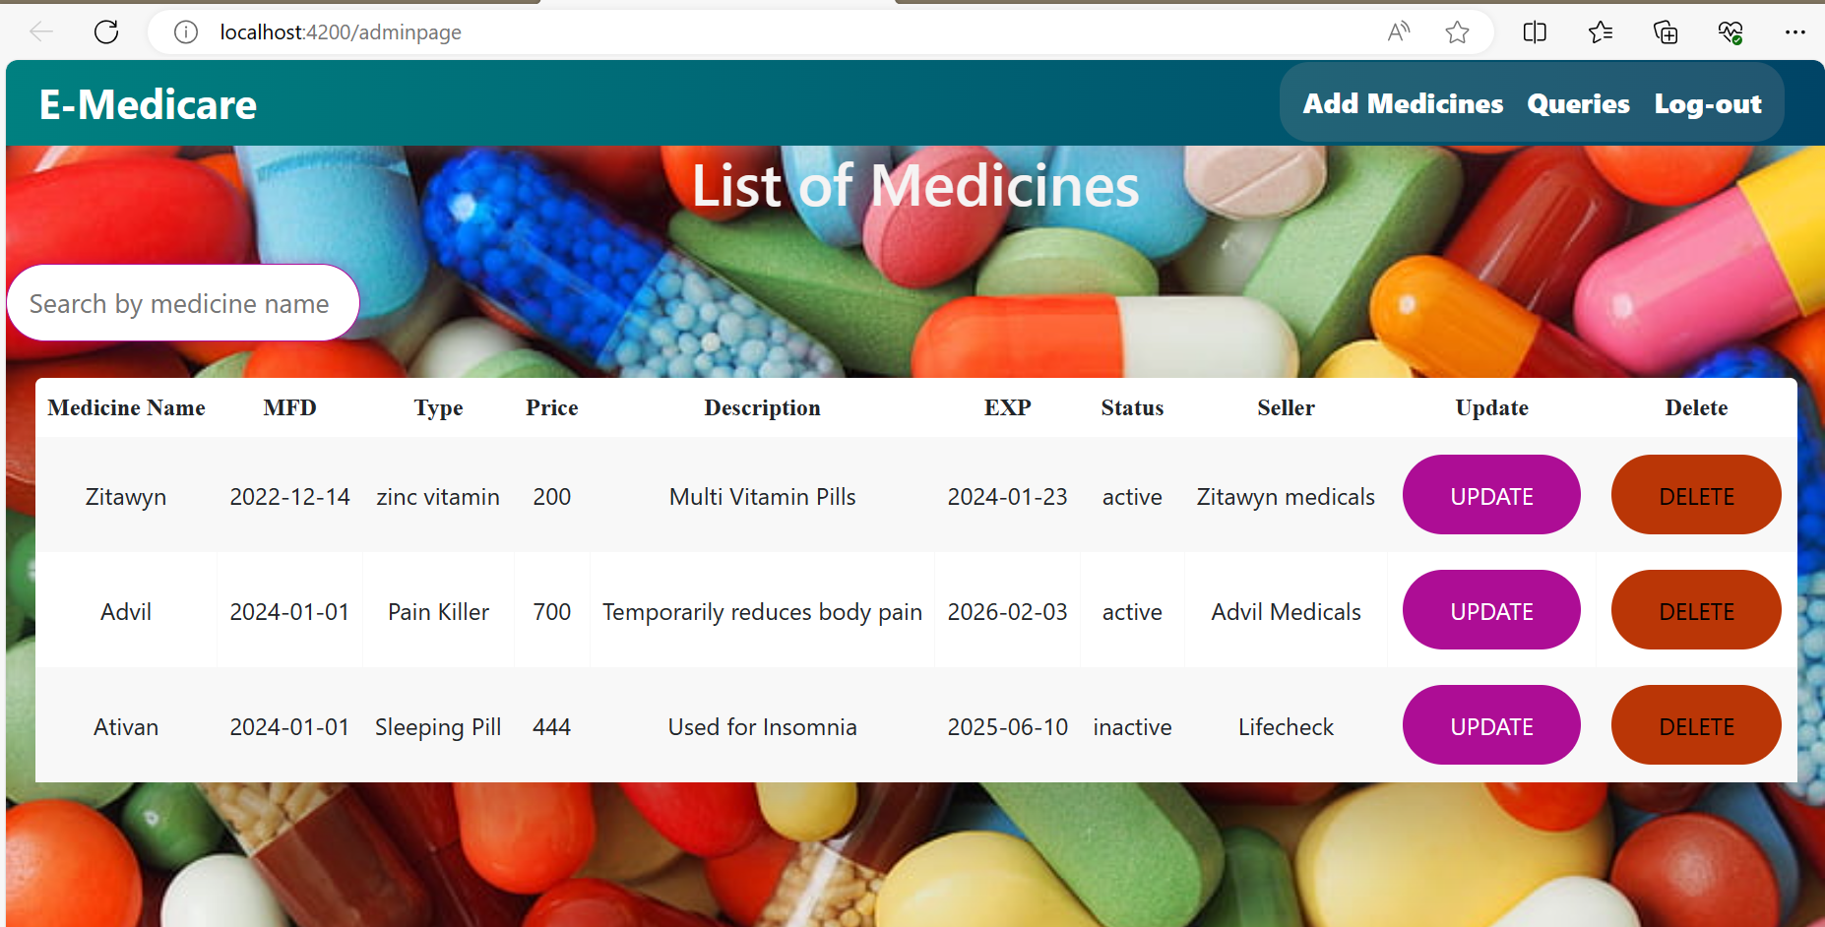
Admin Dashboard

Slide 15
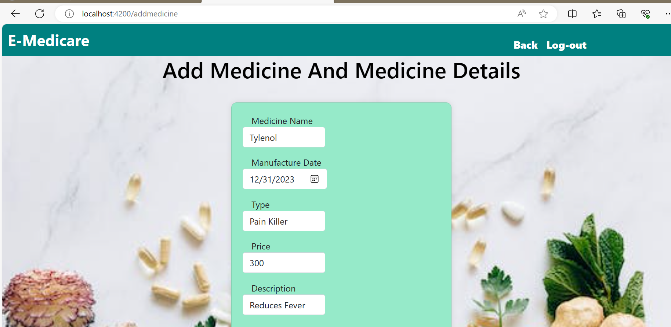
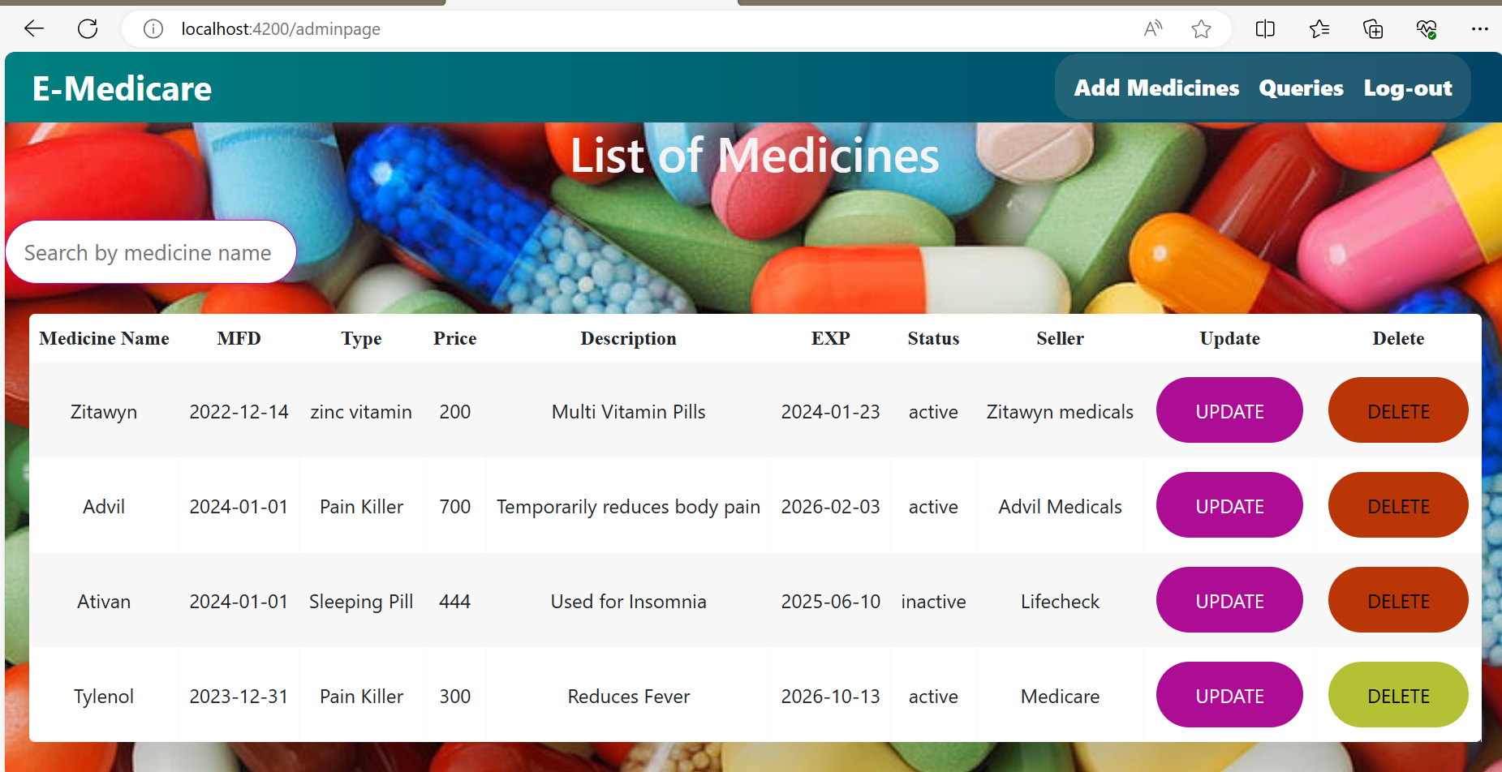
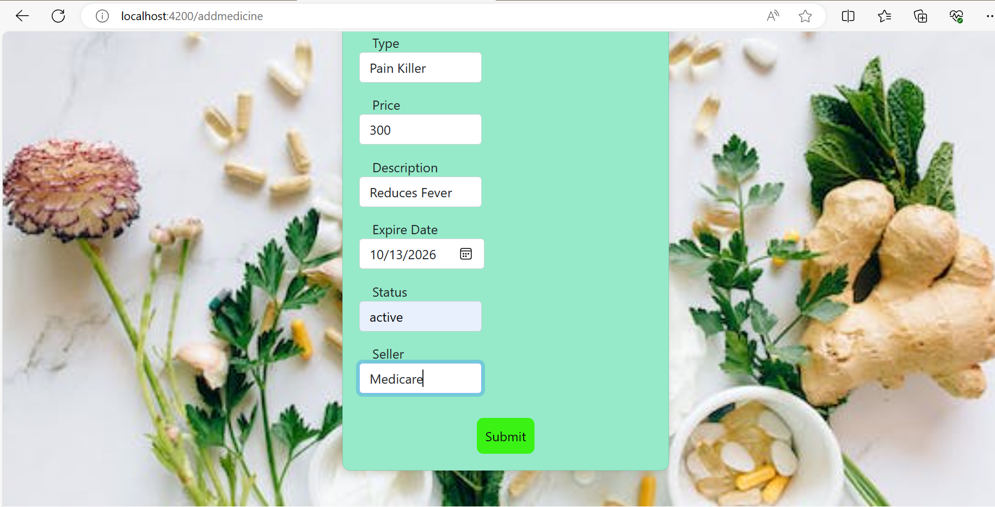
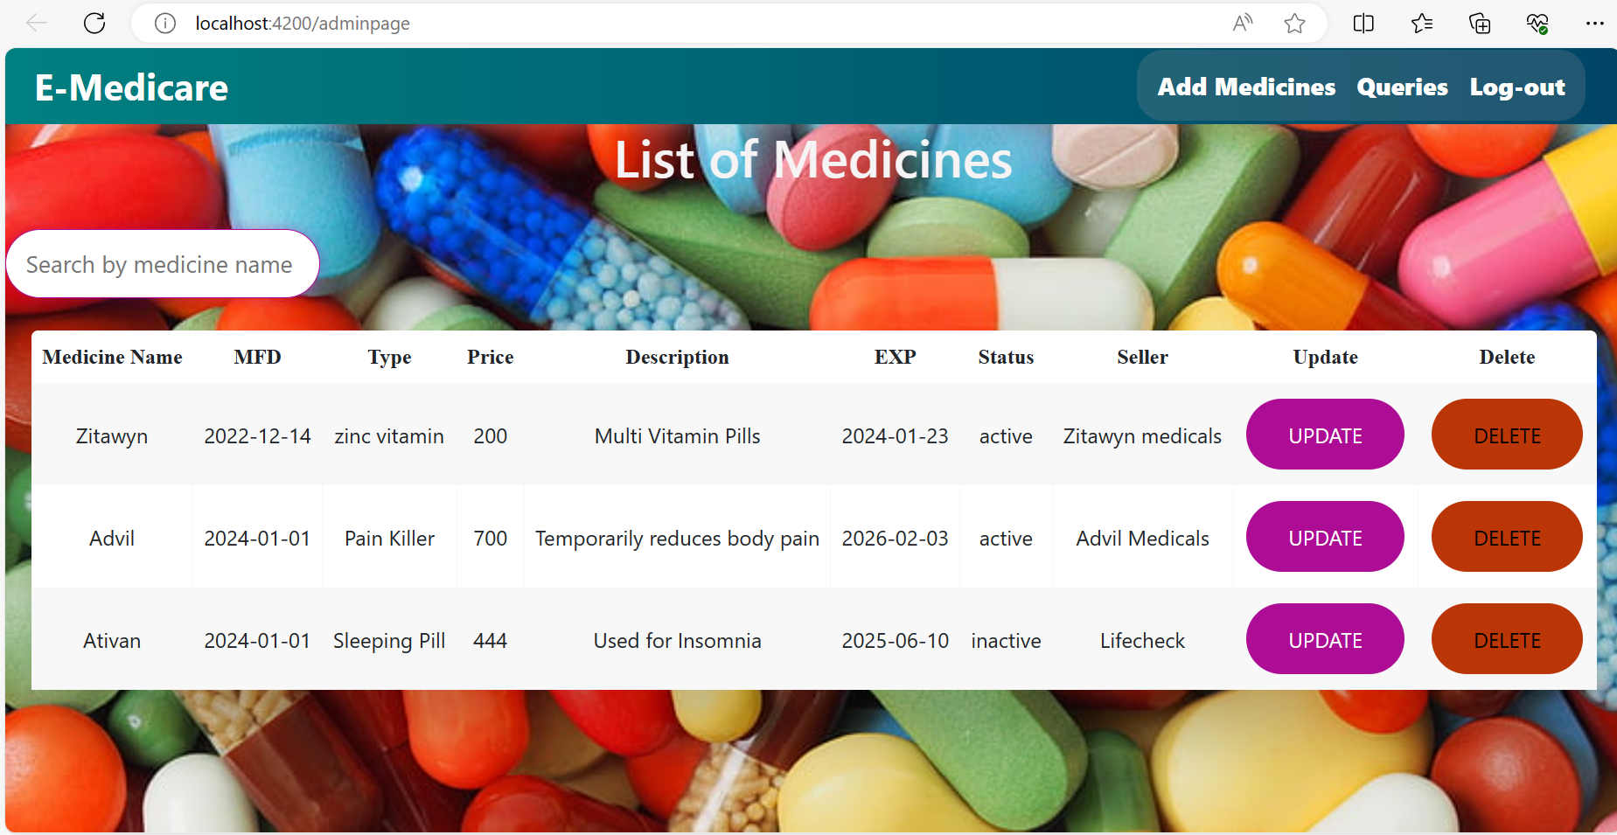
Add Medicine Delete Medicine

Slide 16
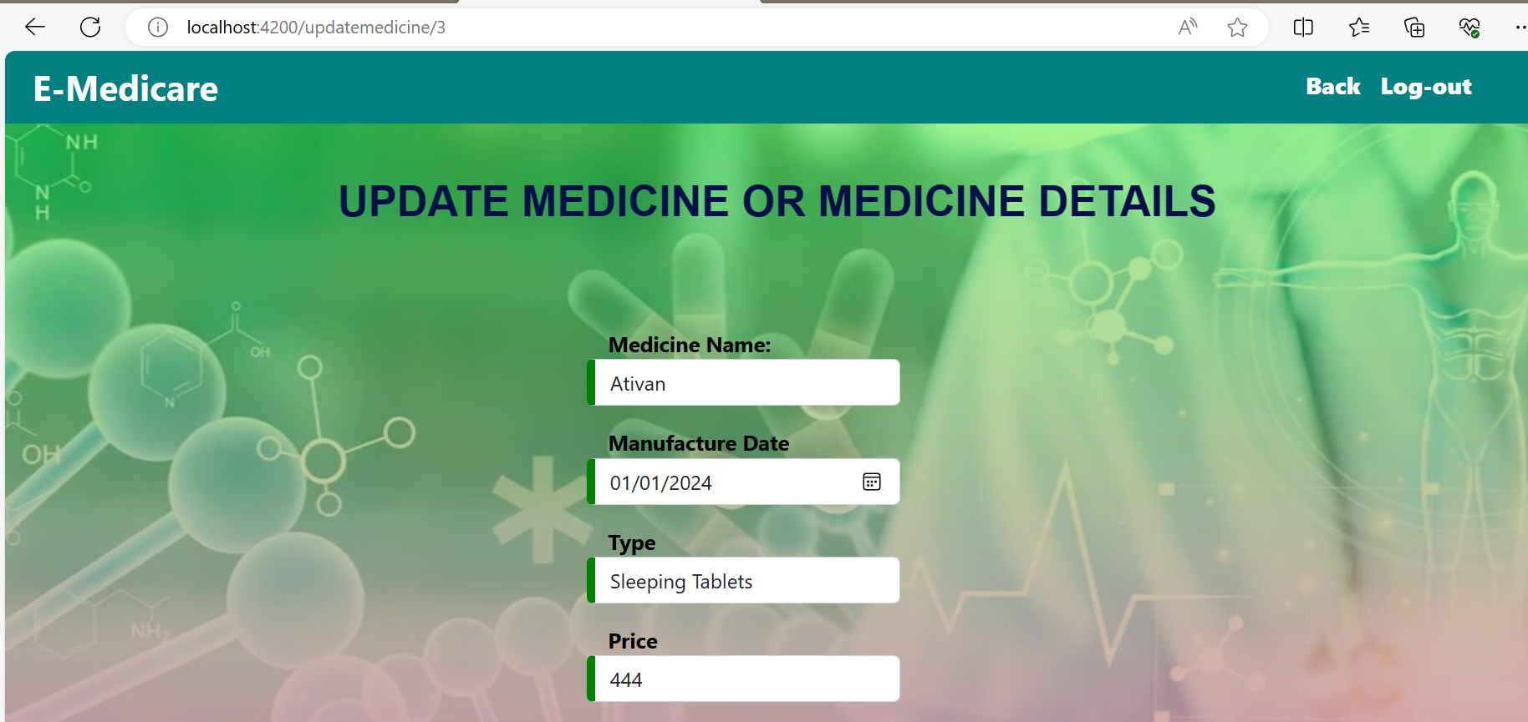
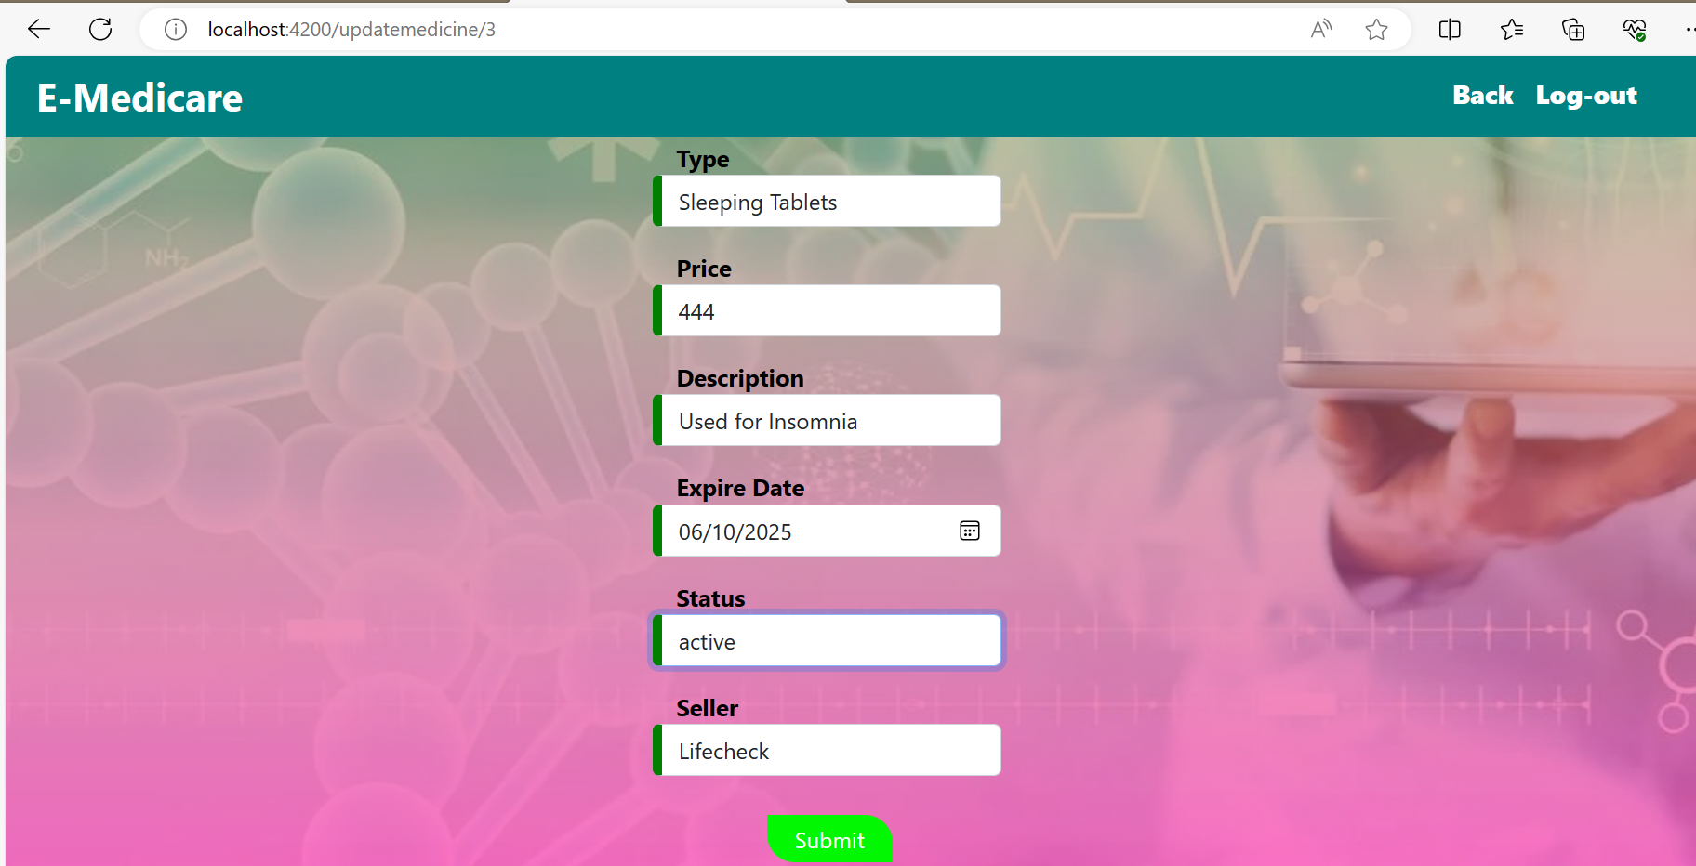
Edit medicines

Slide 17
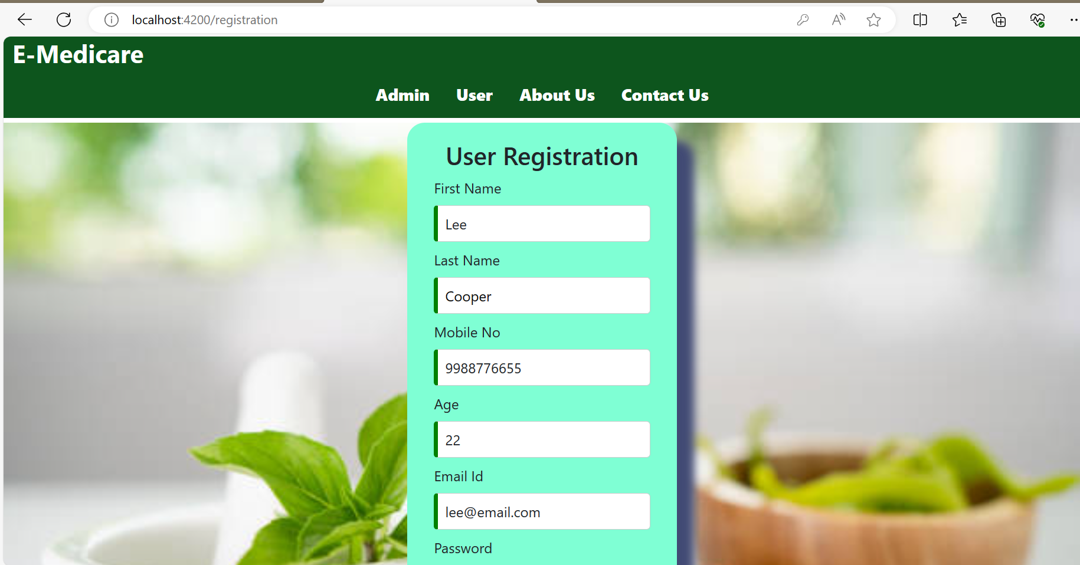
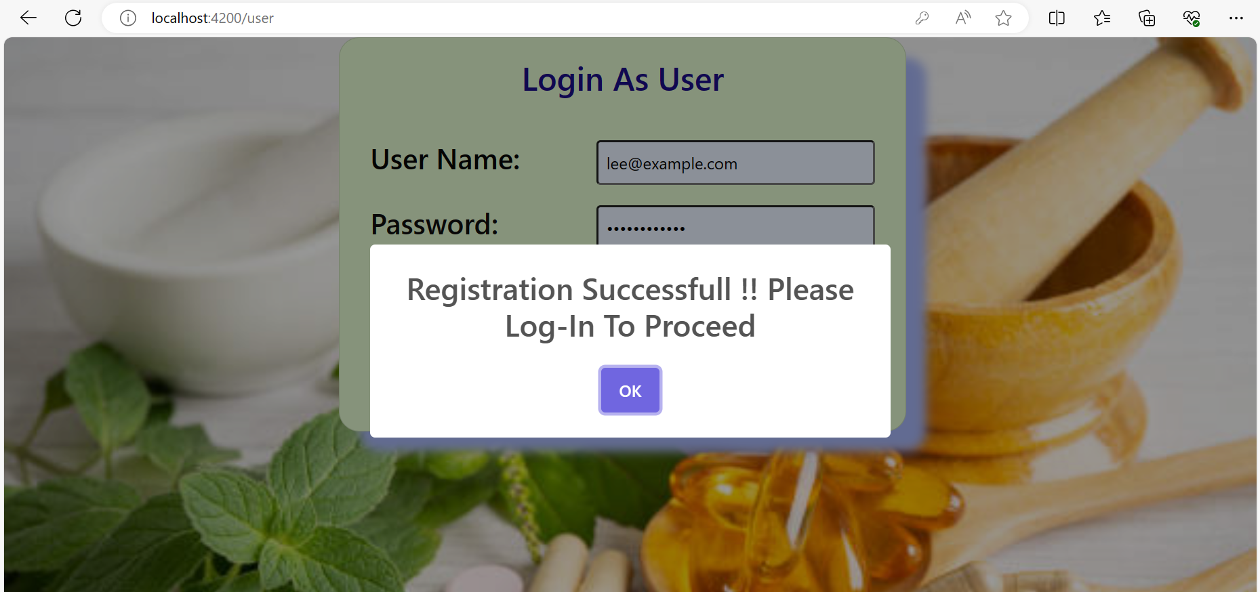

Output Screenshots

Slide 18
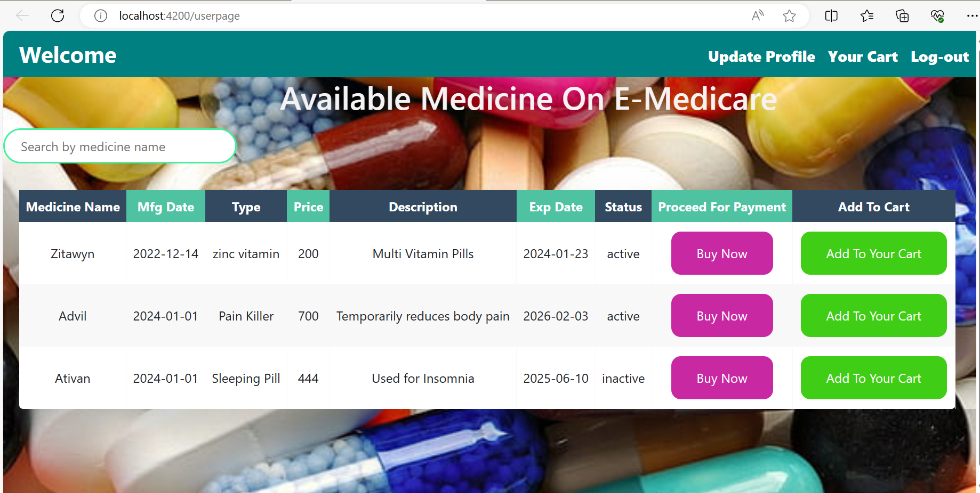
Output Screenshots

Slide 19
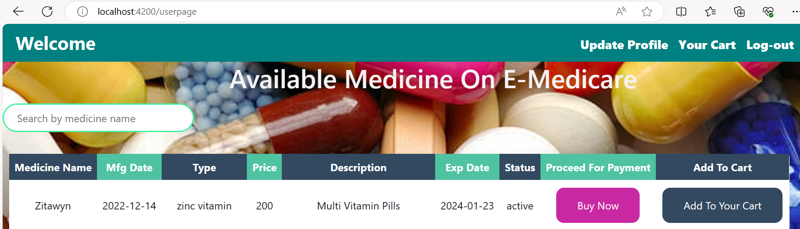
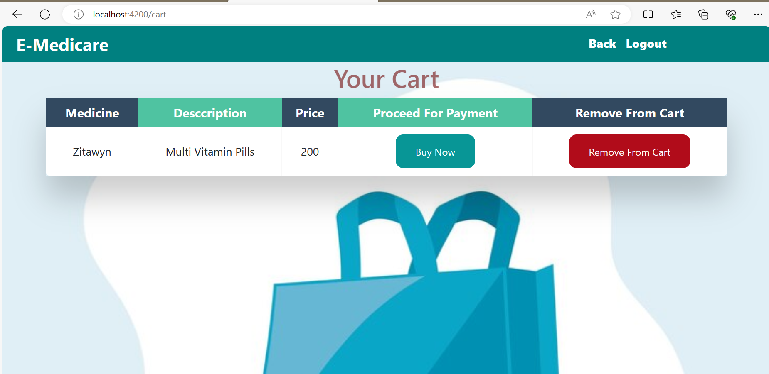
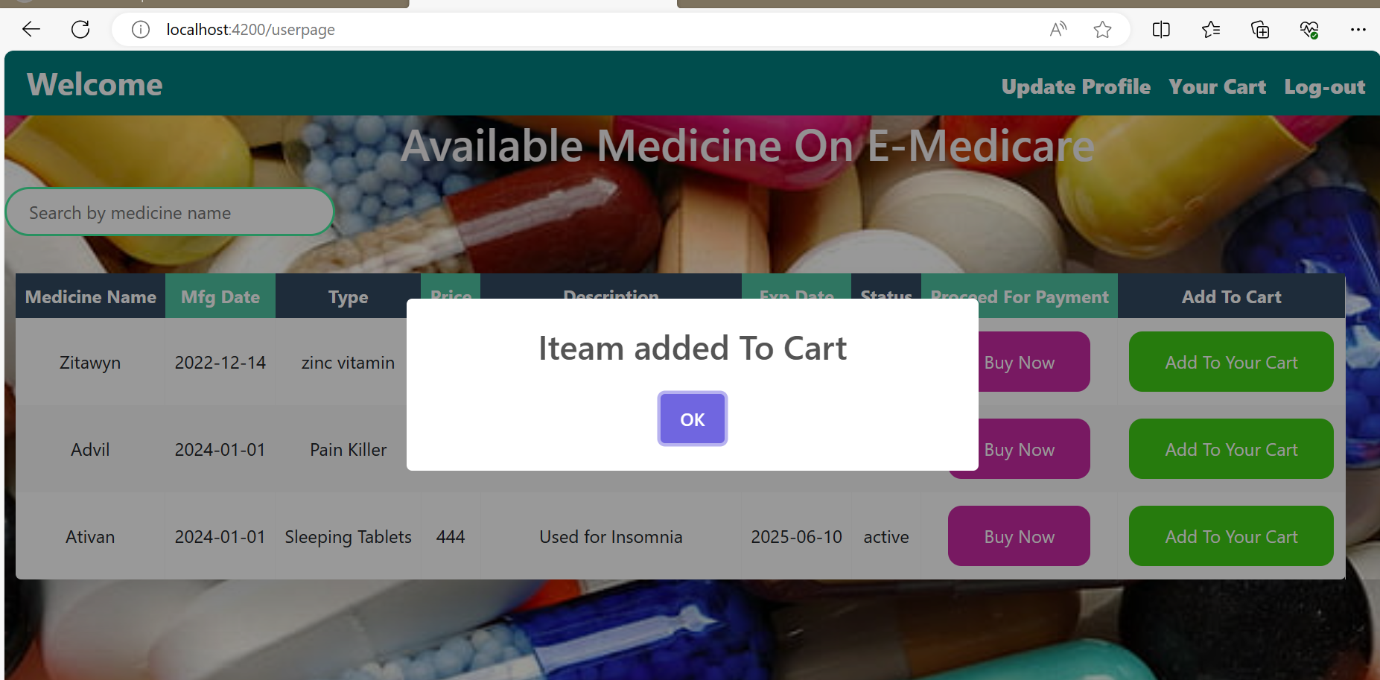
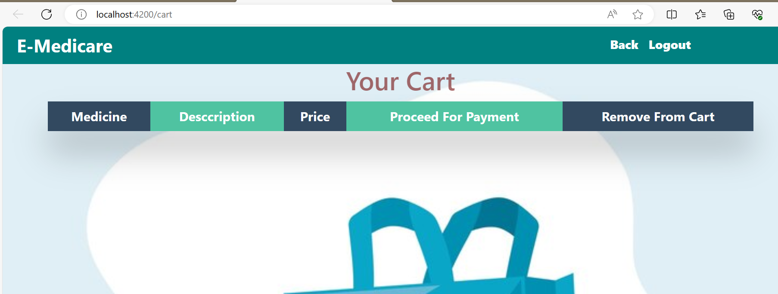
Output Screenshots

Slide 20
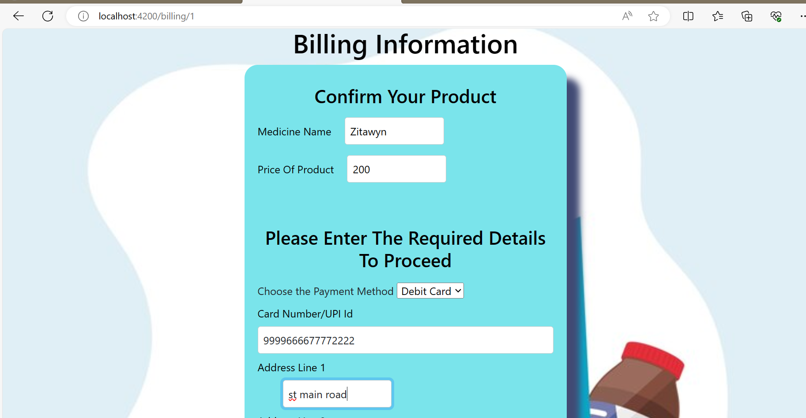
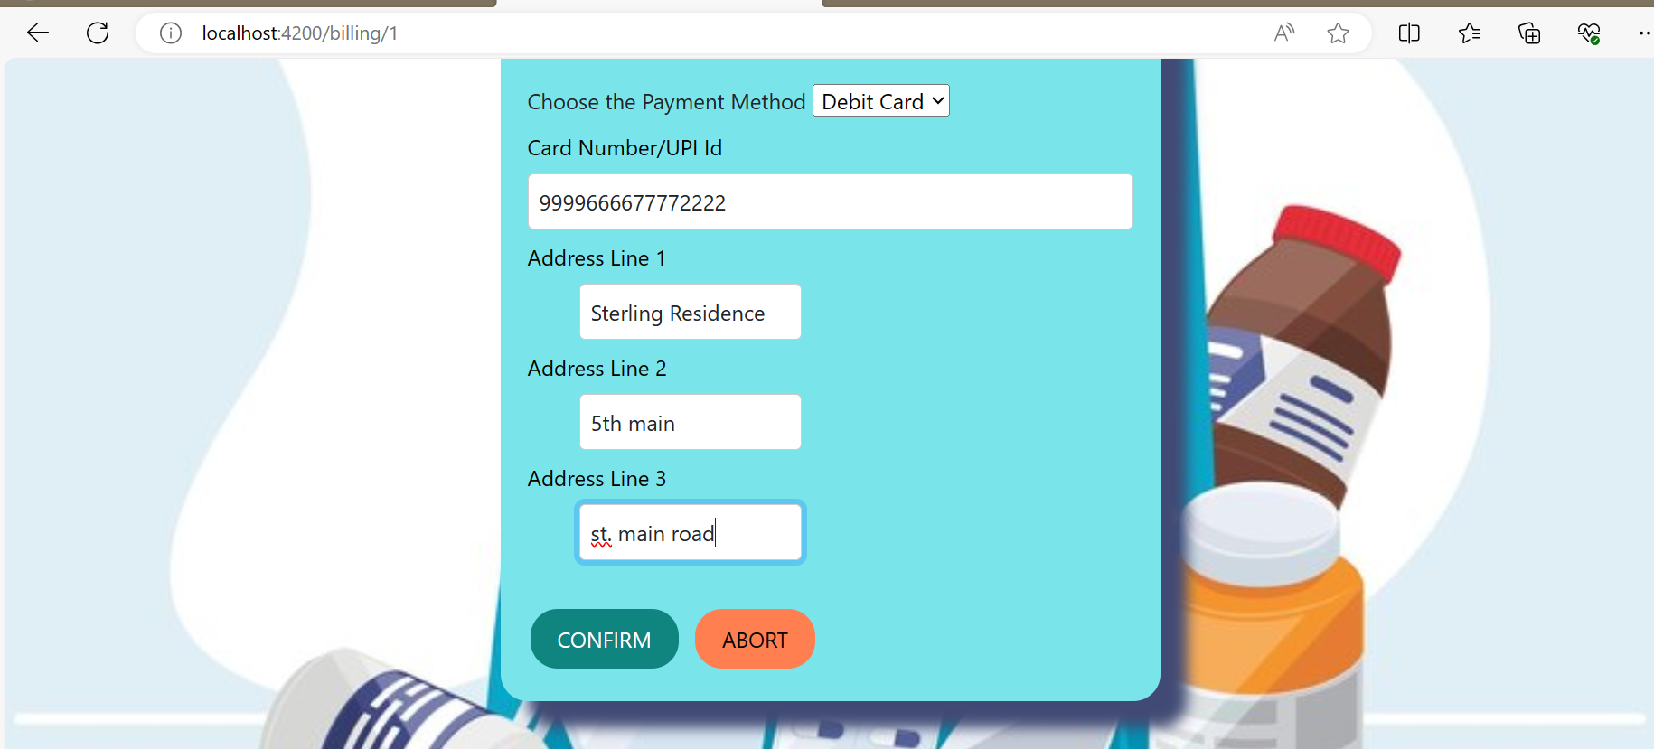
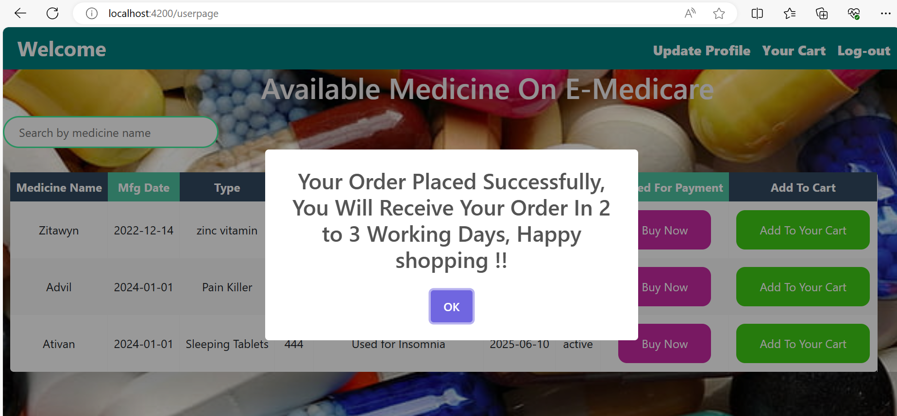
BiLLing information

Slide 21
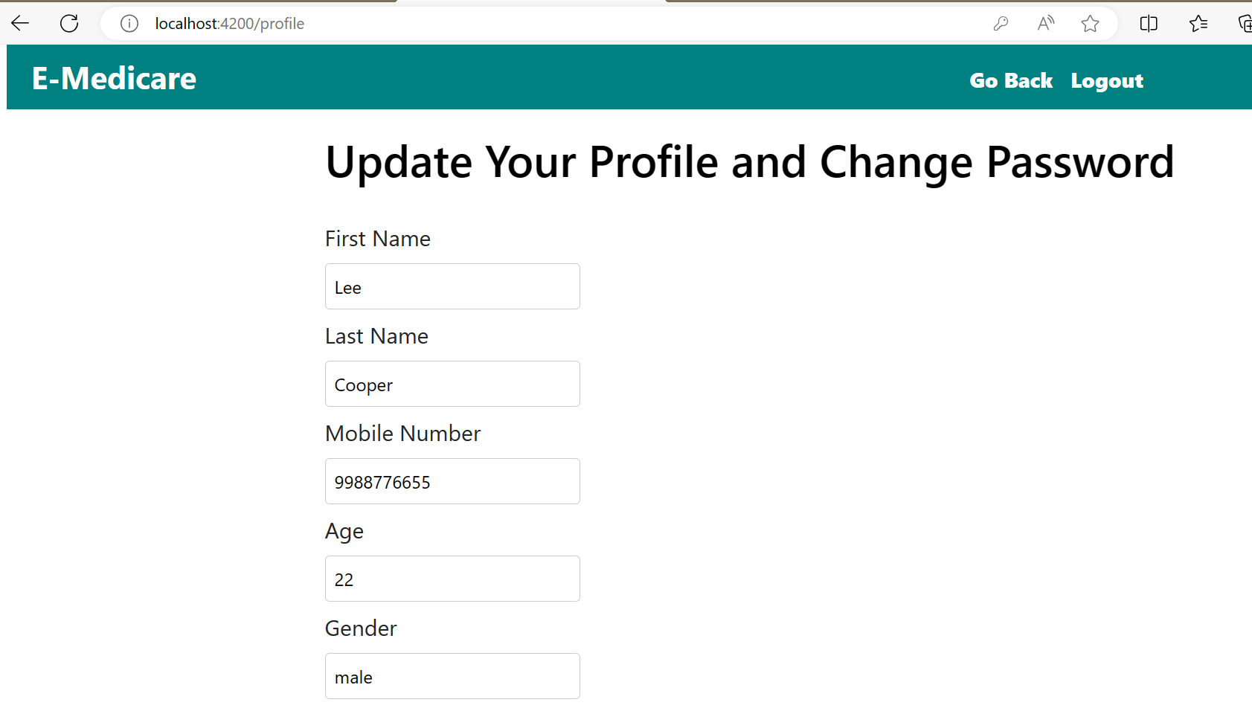
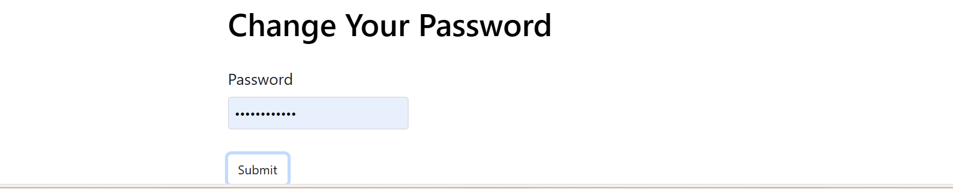
Update user profile

Slide 22
Advantages
• Cost efficient.
• Easy Secured payments.
• User can view different categories of product of different pharma company .
• Saves Money.
• Diminishes Medical Wastes.
• Delivery drug stores accomplish greater accuracy more than the local store.

Slide 23
Conclusion
Our project is only a humble venture to satisfy the needs to manage their project work. Several user-friendly coding has also adopted. The objective of software planning is to provide a framework that enables the manger to make reasonable estimates made within a limited time frame at the beginning of the software project and should be updated regularly as the project progresses.
At the end it is concluded that we have made effort on following points -
We included features and operations in detail, including screen layouts.
We designed user interface and security issues related to system.
Finally, the system is implemented and tested according to test cases.

Slide 24
Thank You !

